Slide 1
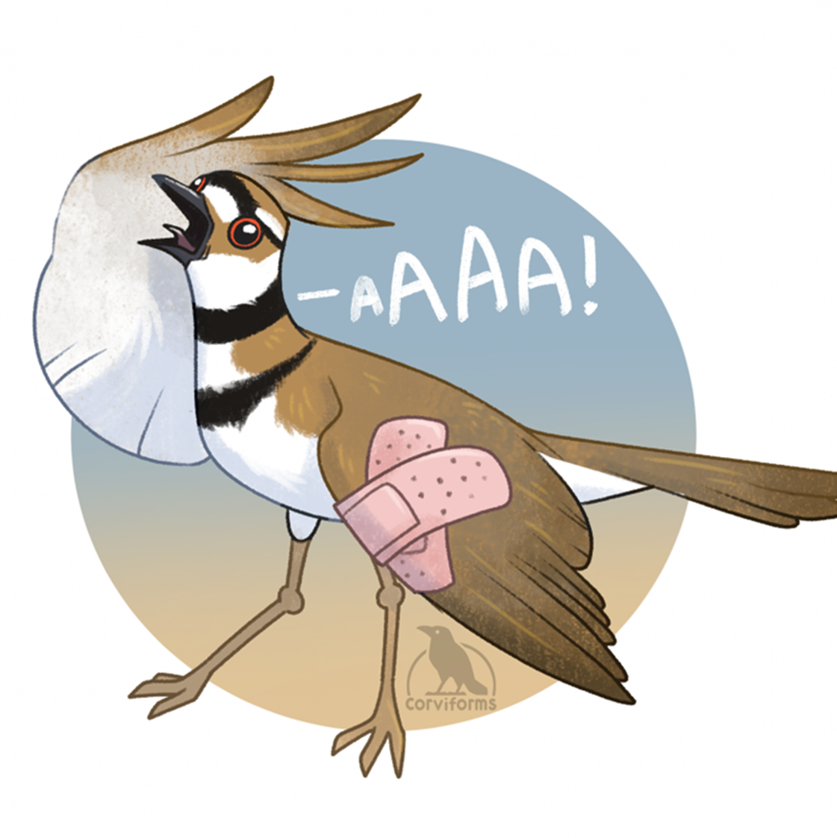
Broken Wing Display & Incubation Patterns in Killdeer
Brandy Williams
School of Biological sciences, EEB
Shizuka Lab

Slide 2
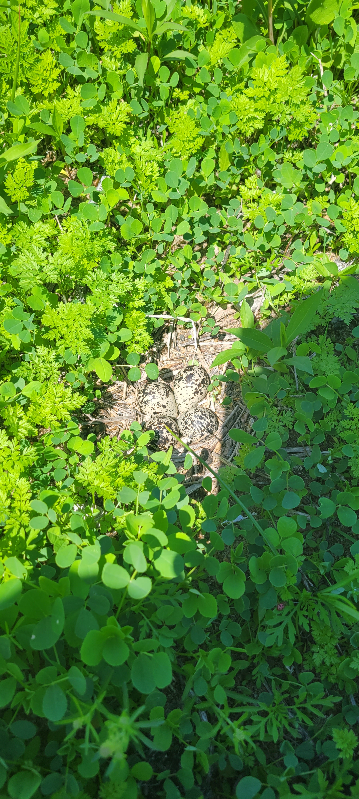
How does nest defense behavior affect offspring?
Nest is left unshaded
How long will the parent do this display?
Is there a potential risk to the eggs?
Nests in rural vs urban environments
Last study looking at Killdeer incubation temperatures was done in 1989

Slide 3
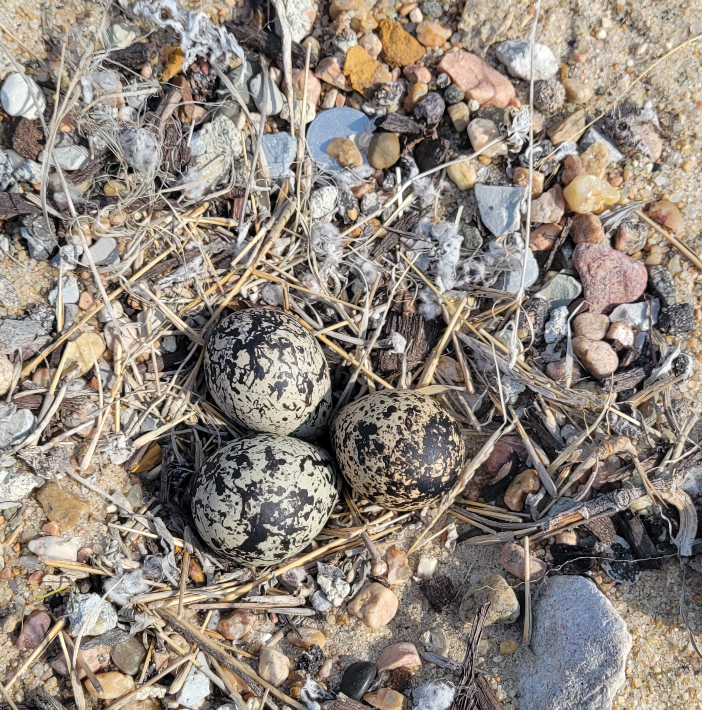
Collecting incubation temperature data in Killdeer
Proposed Methods:
Temperature data loggers
Behavioral observations
Air temperature data
Goal:
Use R to compare air temperatures, nest defense behaviors, and nest temperatures to get the “big picture”

